Slide 1
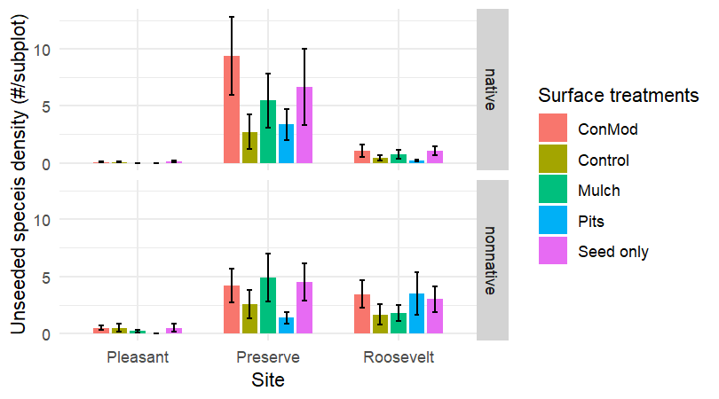
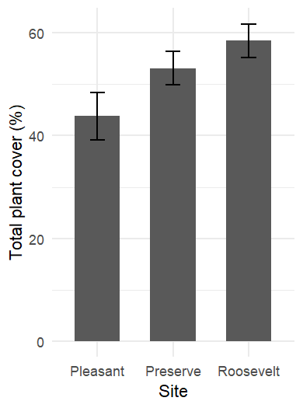
(a)
(b)
Notes:
New fig 5 a and b

Slide 2
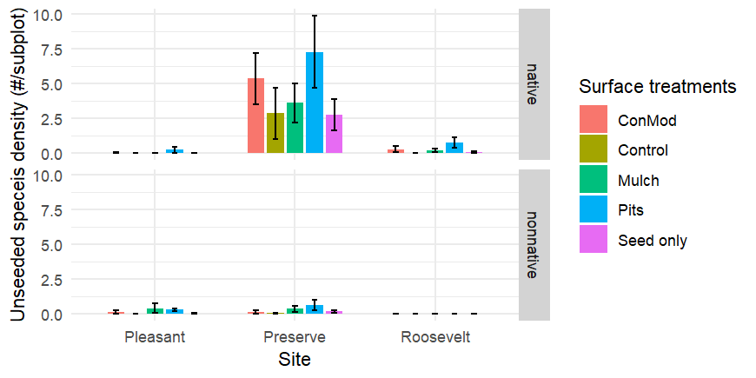
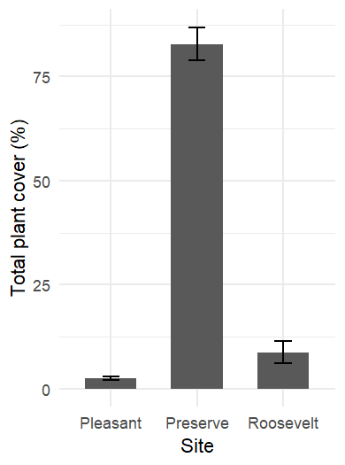
(c)
(d)
Notes:
New fig 5 c and d - Updated fall density plot

Slide 3
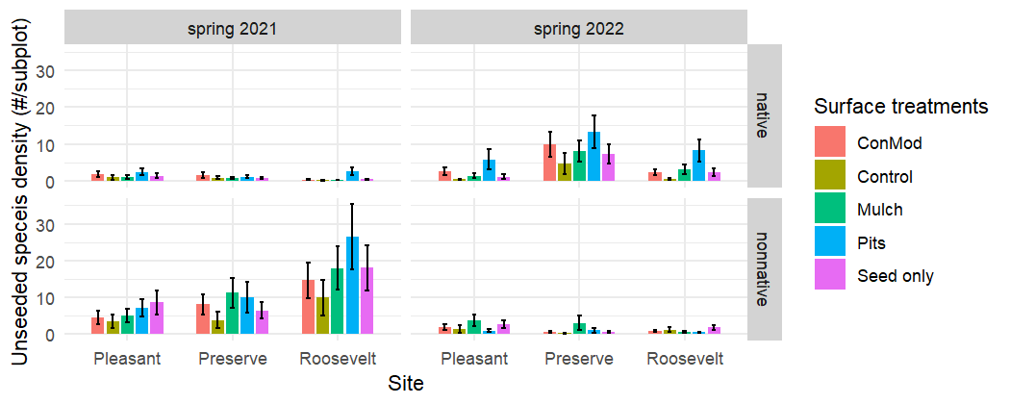
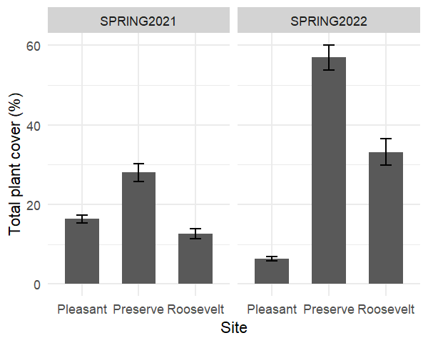
(e)
(f)
Notes:
New fig 5 e and f

